Slide 1


COL874: Advanced Compiler Techniques Modules 176-180
Sanyam Ahuja

Slide 2

Recap
Defined process level metrics for quality of program
Critical applications require more stringent conditions
Ariane V launcher’s failure - estimated cost of overflow
$500M direct cost
$2B indirect cost
Most programs come without any warranty of any kind

Slide 3
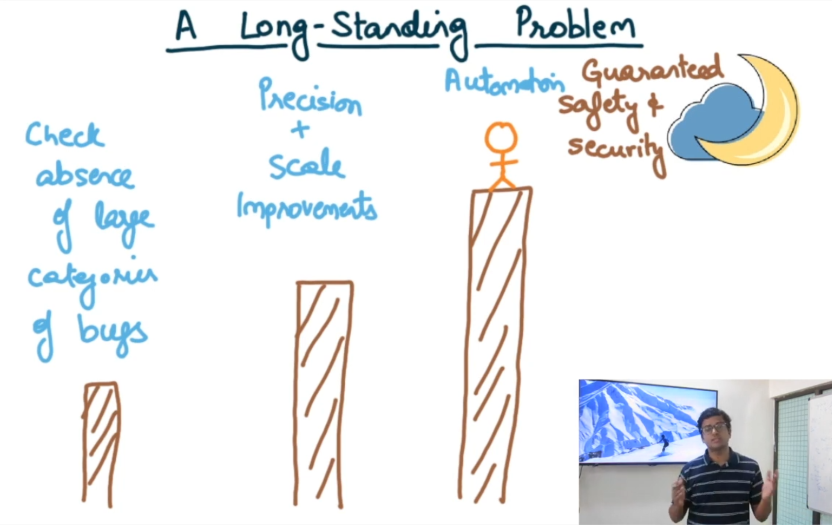
Moving towards moon
“The construction and application of a verifying compiler that guarantees the correctness of a program before running it”
- Tony Hoare, JACM 2003

Slide 4
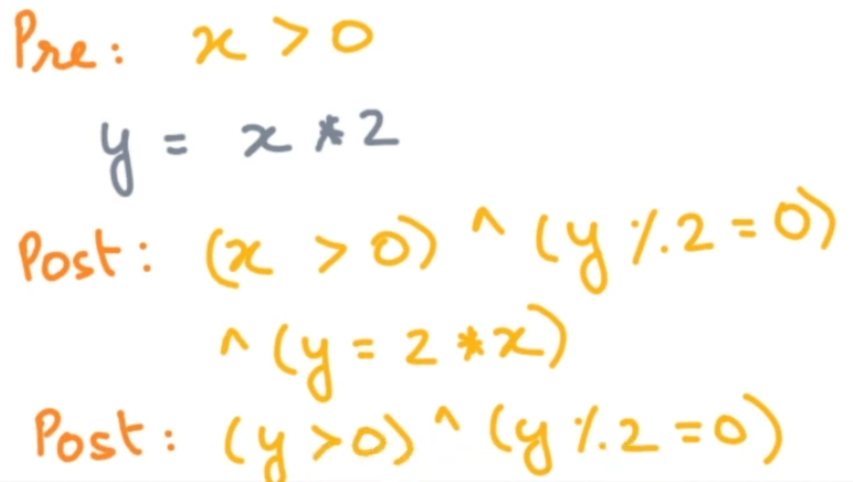
Module 176 : Assertion
A statement (logical predicate) about the values of the program variables at some program execution point.
Precondition and Postcondition
Precondition : Assertion at program entry
Postcondition : Assertion at program exit

Slide 5
Partial Correctness
If precondition P holds on entry of program C and program execution terminates, then postcondition Q holds, if and when the execution of C completes.
Hoare Triple Notation
{P} C {Q}

Slide 6
Hoare Triple Notation Examples
Tautologies
{P} C {true}
{false} C {Q}
Non-terminating program C
{P} C {false}
{P} C {Q}
C : y := 2*x
{true} C {y%2 = 0}
{x=0} C {y=0}
{x<10} C {y<20}
{x<10} C {y%2=0}

Slide 7
Hoare Triple Notation Examples
C :
sum = 0;
for(int i=0; i<n; i++) {
sum += i;
}
{true} C {sum = n(n-1)/2}

Slide 8
Abstraction
An assertion that holds can be called an abstraction
y = 2,6,8,10,…
Assertion : {y>0 ^ y%2=0}
An abstraction can add more behaviors, but not remove any

Slide 9
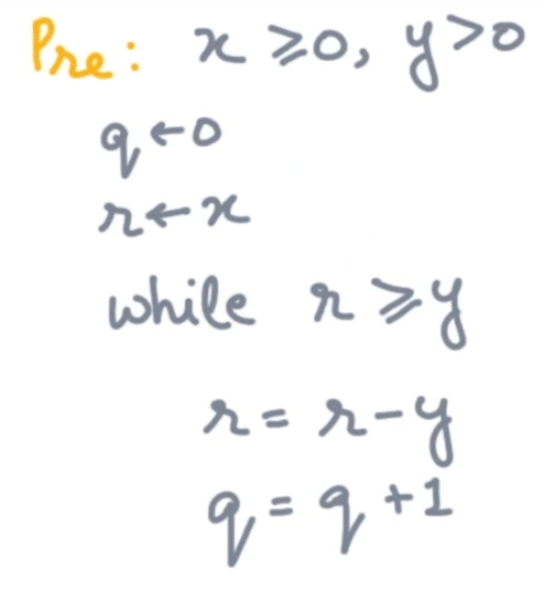
Module 177 : Invariants
Invariant at a program point is an assertion that holds during execution whenever control reaches that point

Slide 10
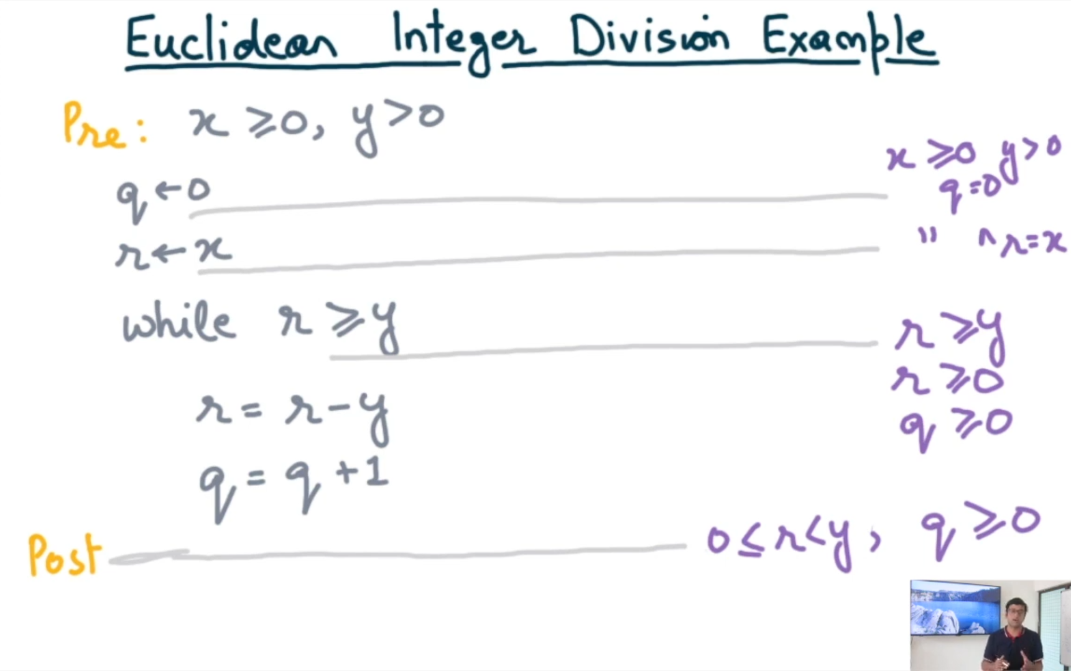

Slide 11
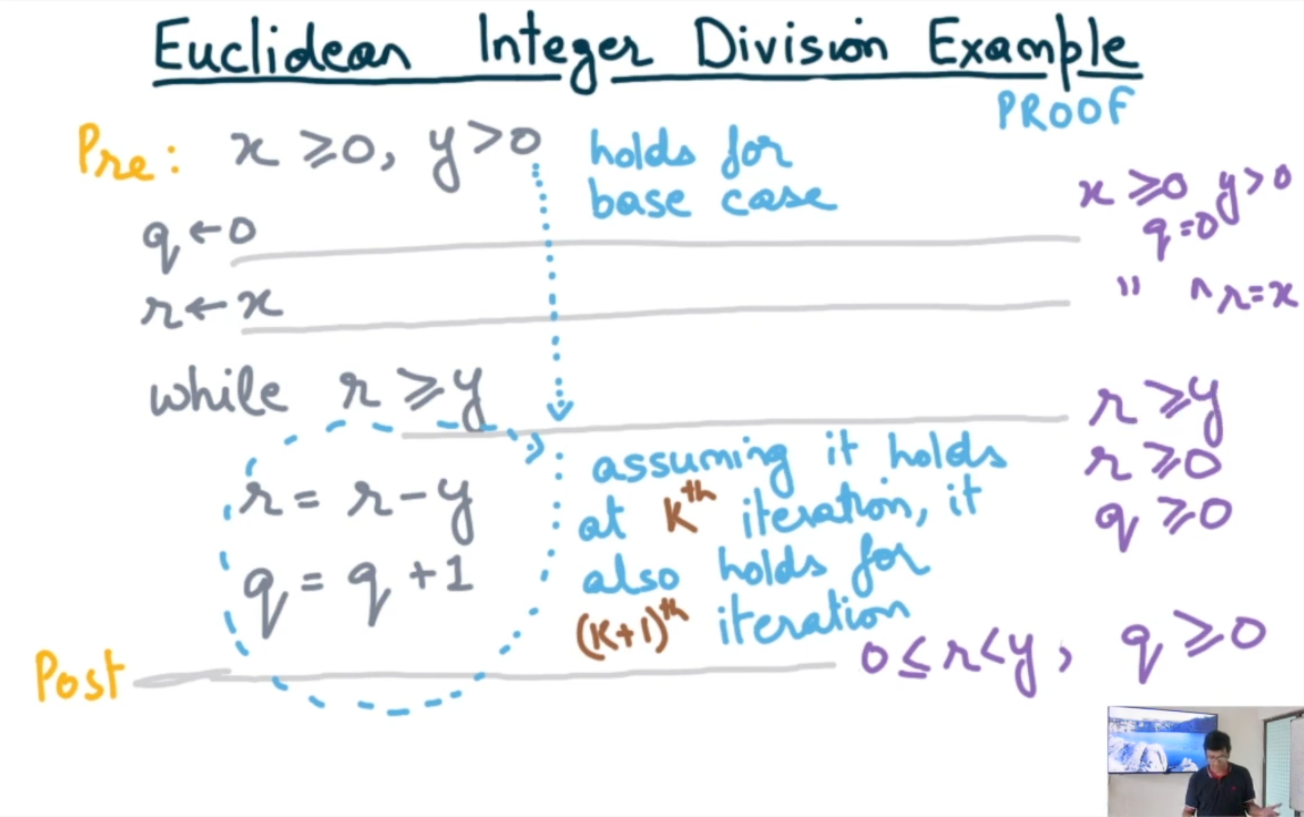
Induction on the number of program steps. Also called inductive invariants

Slide 12
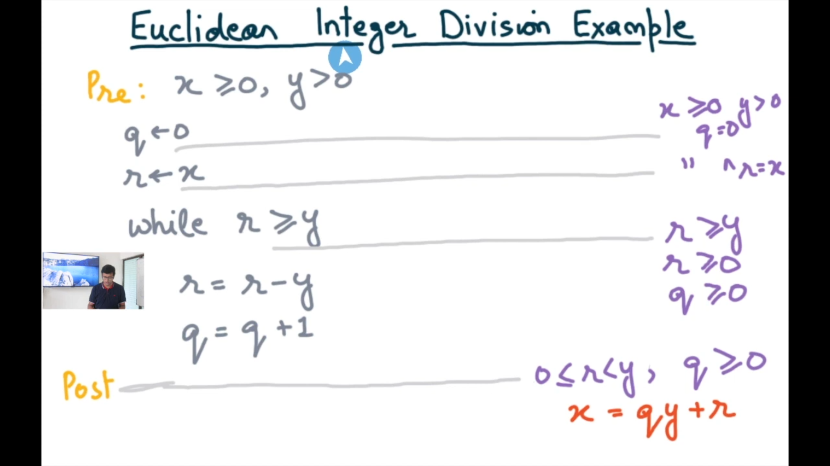

Slide 13
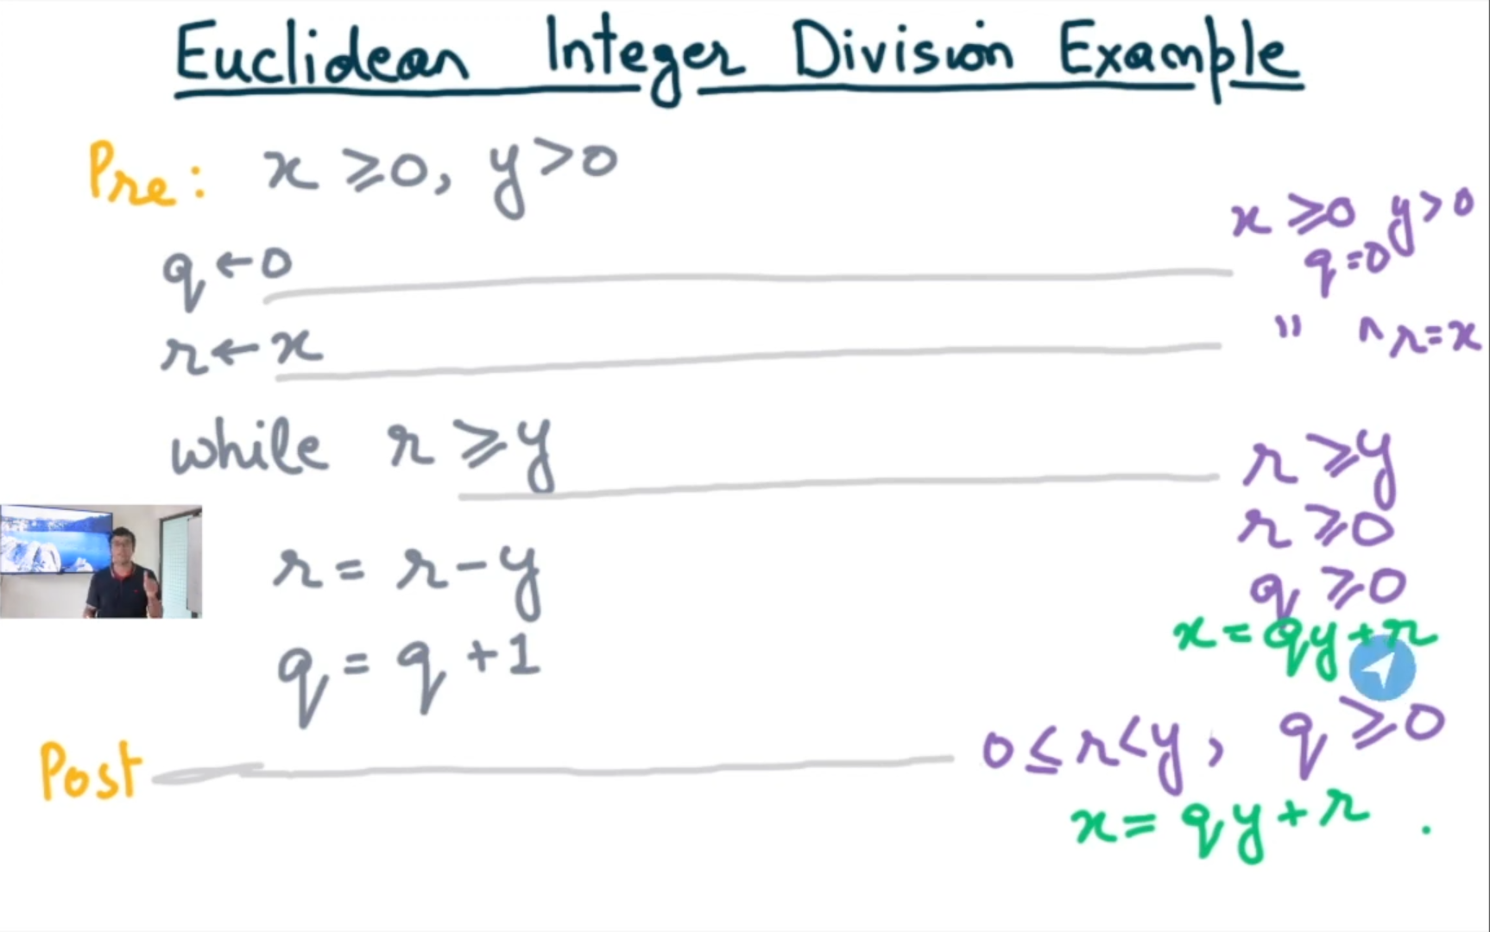

Slide 14

Module 178 : Verification Conditions

Slide 15
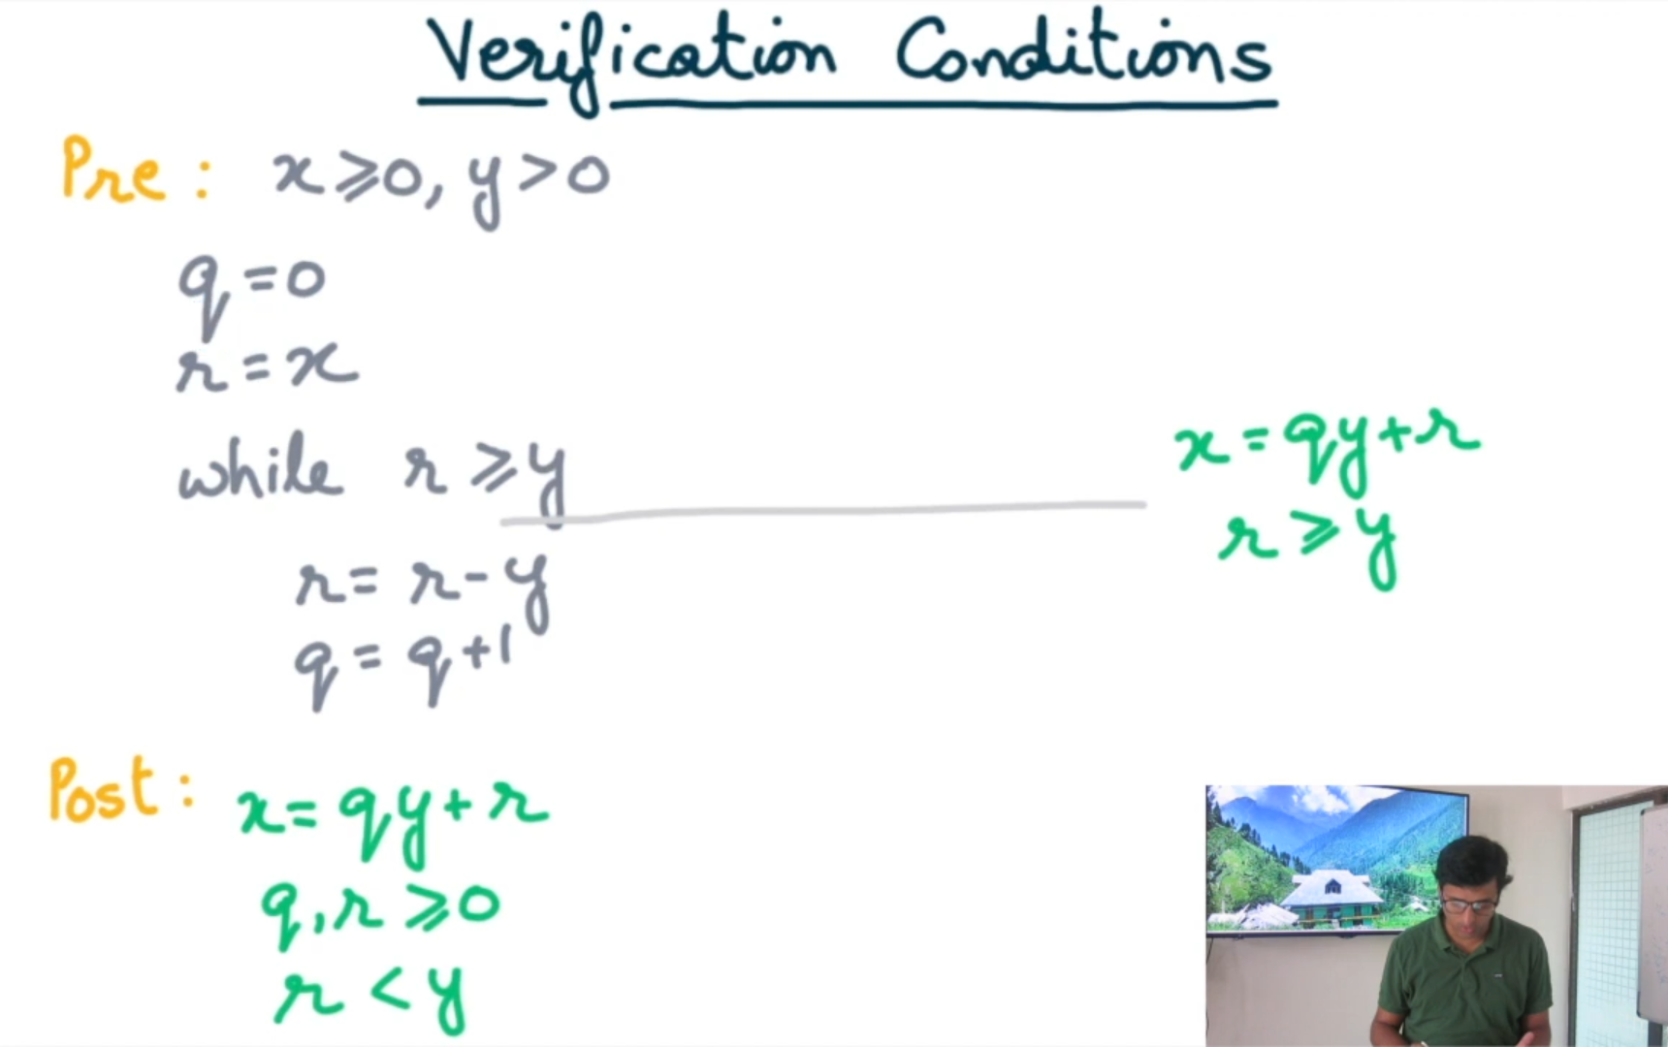

Slide 16
Verification Conditions
Verification Condition 1(VC1)
{x>=0, y>0} q=0; r=x;
if(r>=y)
{x=qy+r, r>=y}
Verification Condition 2(VC2)
{x=qy+r, r>=y} r’=r-y; q’=q+1;
if(r’>=y)
{x=q’y+r’, r’>=y}
Verification Condition 3(VC3)
{x=qy+r, r>=y} r’=r-y; q’=q+1;
if not(r’>=y)
{x=q’y+r’, r’<y}

Slide 17

Verification Conditions
Precondition:
C:
Postcondition:
{x>=0, y>0} q=0;
r=x;
while(r>=y)
r=r-y;
q=q+1;
{x=qy+r, q,r>=0, r<y}
VC1 ^ VC2 ^ VC3
{x>=0, y>0}
C
{x=qy+r, r<y, q,r>=0}

Slide 18


Assignment Verification Condition
Precondition:
C:
Postcondition:
{P(X,Y,…)} X := E(X,Y,…)
{Q(X,Y,…)}
∀ X,Y,… : (∃X’:P(X’,Y,…) ^ X=E(X’,Y,…)) Q(X,Y,…)
(Floyd)
∀ X,Y,… : P(X,Y,…) Q(X,Y,…)[X:=E]
(Hoare)
B[x:=A] represents substitution of A for x in B

Slide 19


Assignment VC Example
Precondition:
C:
Postcondition:
{X>=0} X := X+1
{X>0}
∀ X : (∃X’:X’>=0 ^ X=X’+1) X>0
(Floyd)
∀ X : X>=0 X+1>0
(Hoare)

Slide 20
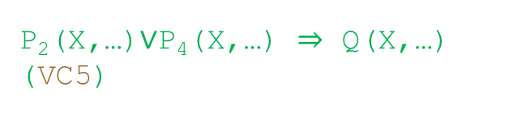
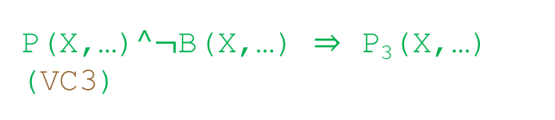
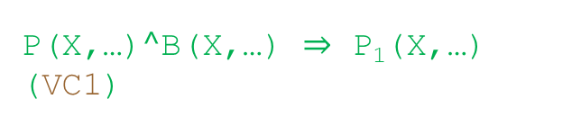
Module 179: Conditional Verification Condition
{P(X,…)}
if B(X,…) then
…
else
…
fi
{Q(X,…)}
{P₁(X,…)}
{P₂(X,…)}
{P₃(X,…)}
{P₄(X,…)}
P(X,…)$^$B(X,…) P₁(X,…)
(VC1)
P(X,…)$^¬$B(X,…) P₃(X,…)
(VC3)
P₂(X,…)$∨$P₄(X,…) Q(X,…)
(VC5)

Slide 21
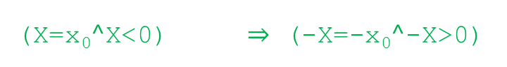
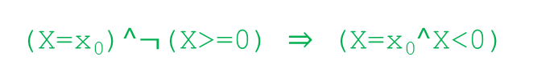
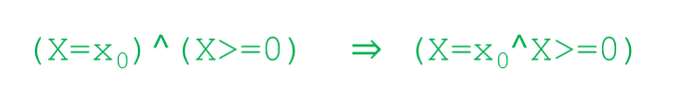
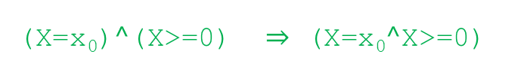

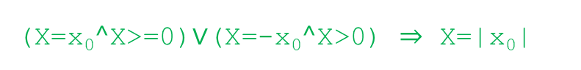
Conditional VC Example
if X>=0 then
skip
else
X := -X
{X=x₀}
{X=|x₀|}
{X=x₀$^$X>=0}
{X=x₀$^$X>=0}
{X=x₀$^$X<0}
{X=-x₀$^$X>0}
(X=x₀)$^$(X>=0) (X=x₀$^$X>=0)
(VC1)
(X=x₀)$^$(X>=0) (X=x₀$^$X>=0)
(VC2)
(X=x₀)$^¬$(X>=0) (X=x₀$^$X<0)
(VC3)
(X=x₀$^$X<0) (-X=-x₀$^$-X>0)
(VC4)
(X=x₀$^$X>=0)$∨$(X=-x₀$^$X>0) X=|x₀|
(VC5)

Slide 22
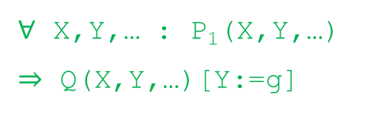
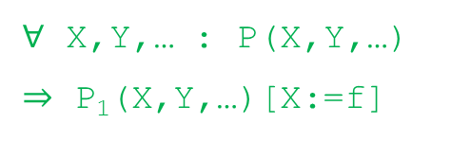
Module 180: Sequence Operator Verification Condition
∀ X,Y,… : P(X,Y,…) P₁(X,Y,…)[X:=f]
X:=f(X,Y,…)
Y:=g(X,Y,…)
{P(X,Y,…)}
{Q(X,Y,…)}
{P₁(X,Y,…)}
∀ X,Y,… : P₁(X,Y,…) Q(X,Y,…)[Y:=g]
{P} s₁ {P₁}
{P₁} s₂ {Q}
Choose P₁(X,Y,…)=Q(X,Y,…)[Y:=g]

Slide 23
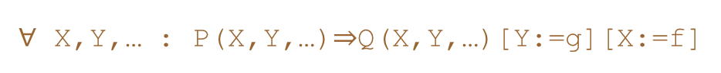
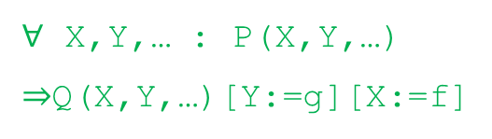
Module 180: Sequence Operator Verification Condition
∀ X,Y,… : P(X,Y,…) Q(X,Y,…)[Y:=g][X:=f]
X:=f(X,Y,…)
Y:=g(X,Y,…)
{P(X,Y,…)}
{Q(X,Y,…)}
{Q(X,Y,…)[Y:=g]}
∀ X,Y,… : P(X,Y,…)Q(X,Y,…)[Y:=g][X:=f]

Slide 24
Thank You

